Slide 1
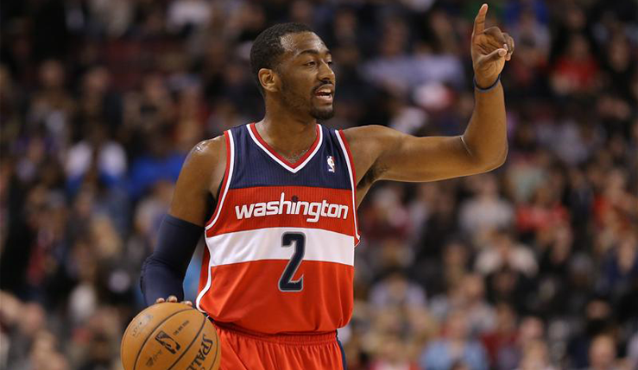
NBA
By: Daniel Espinoza

Slide 2
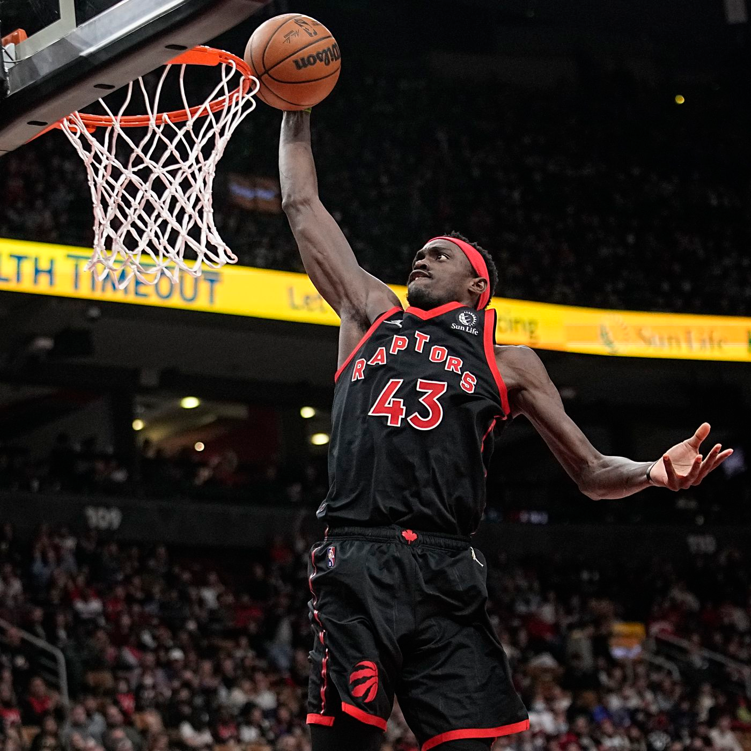
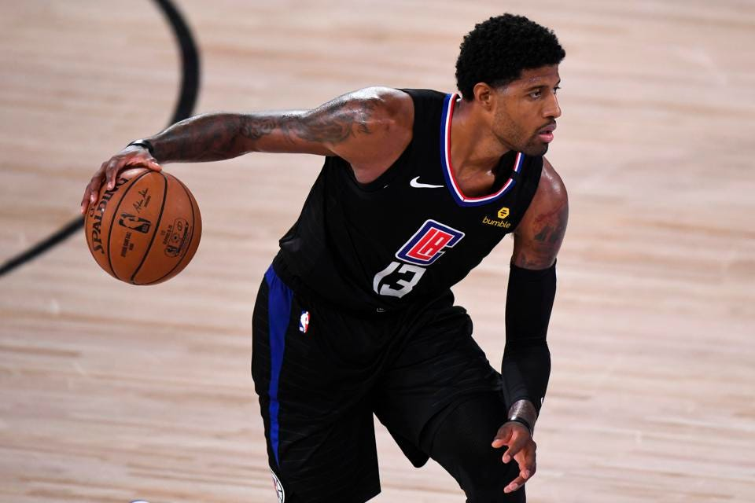
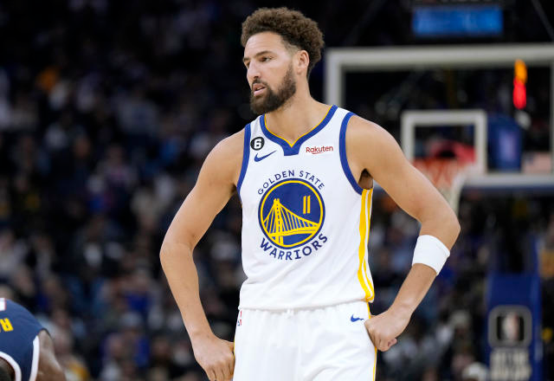
Problem
NBA trade deadline is coming up and we are in need for some players to make the Finals.
We need a PG and a C to be confident in the playoffs

Slide 3
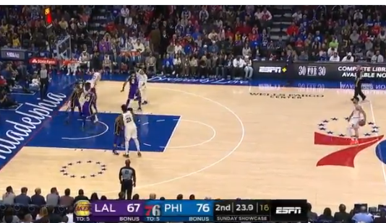
Methodology
Point Guard: high assist/game and average points/game
Center: high 3 point percentage and high FT percentage
Only have players that have been a all star or playoff appearance in the last decade

Slide 4
Finding /Insight
Used two CSV file.
NBA - Has all the current stats of NBA players playing up to today
NBASTARS - Has all the players that have been in the playoffs or had an all star appearance

Slide 5
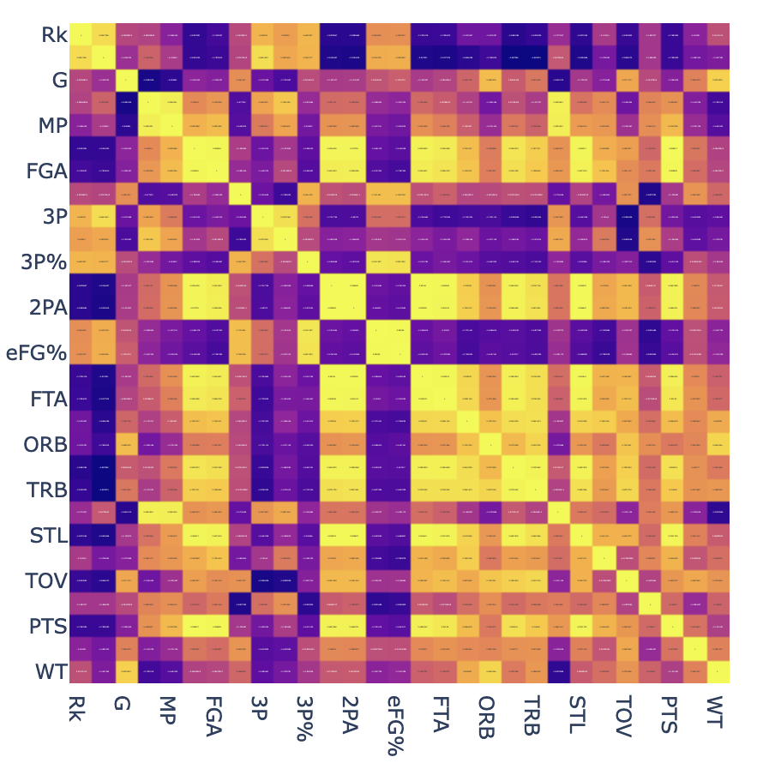
Findings/Insights
Centers heat map
NBA DF

Slide 6
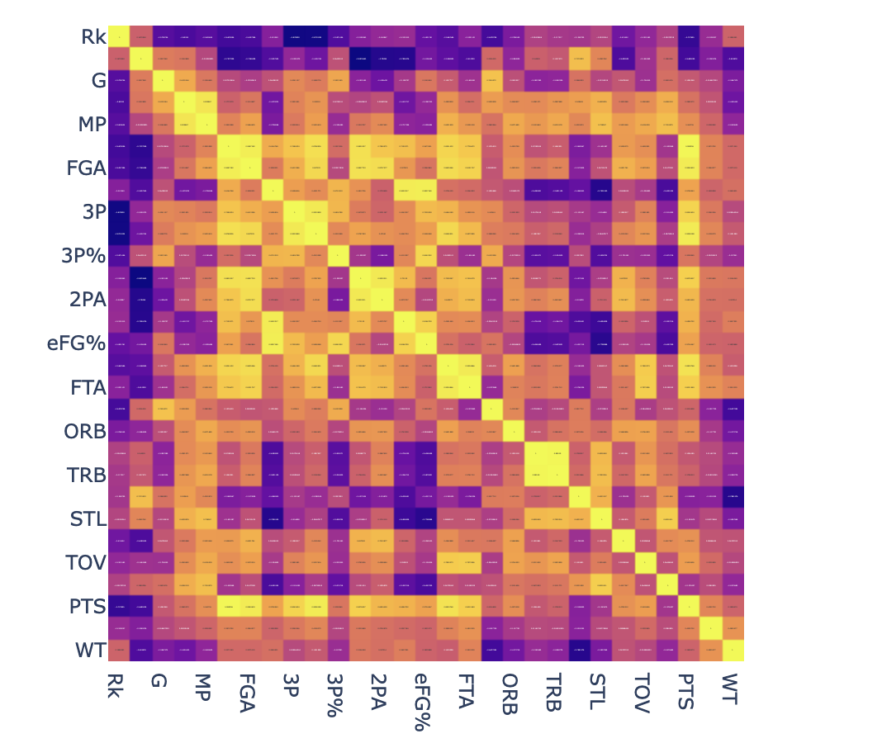
Findings/Insights
PG heat map
NBA DF

Slide 7
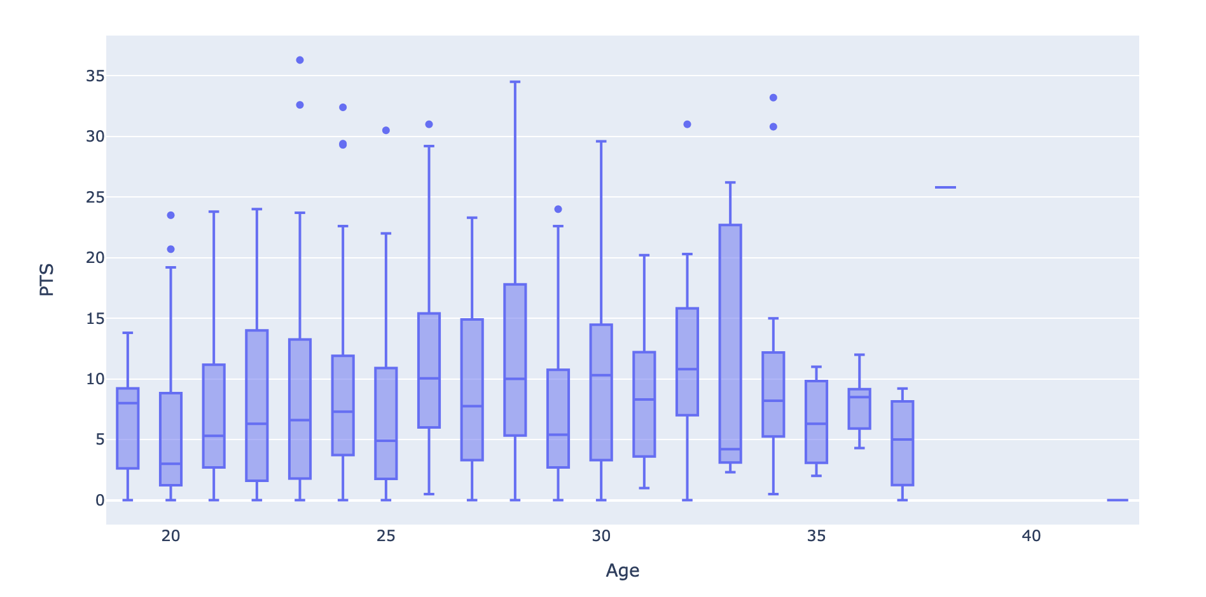
Findings/Insights

Slide 8
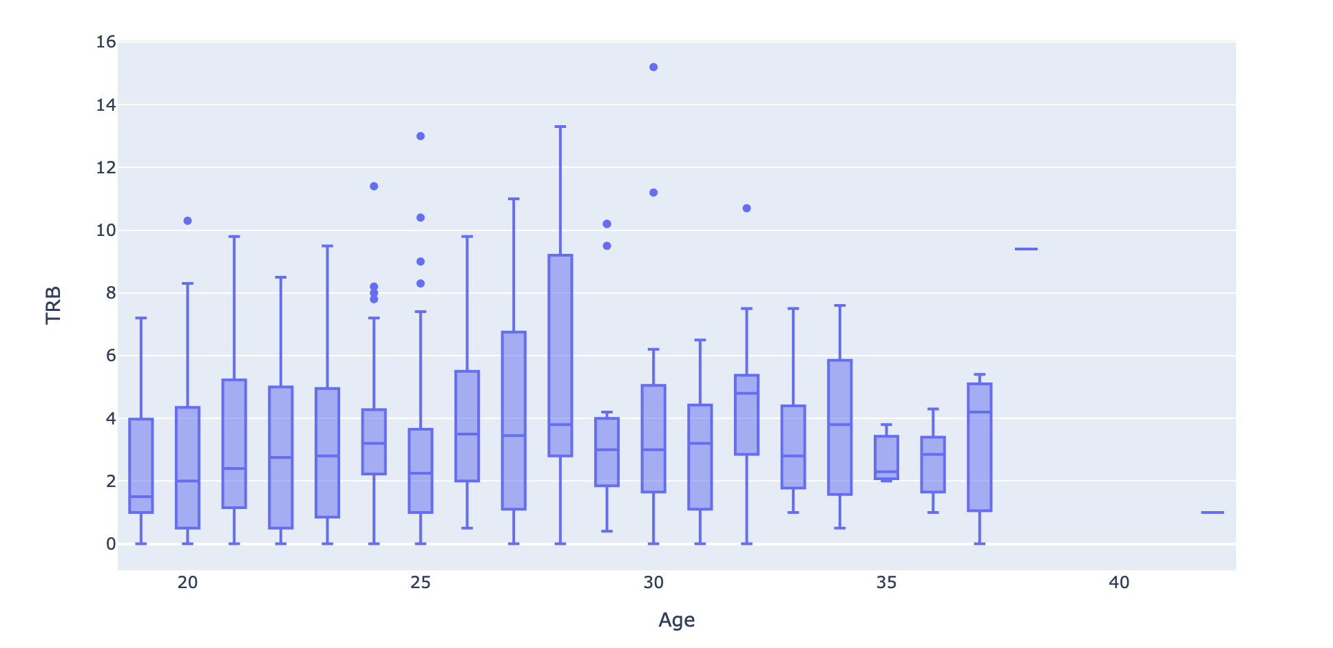
Findings/Insights

Slide 9
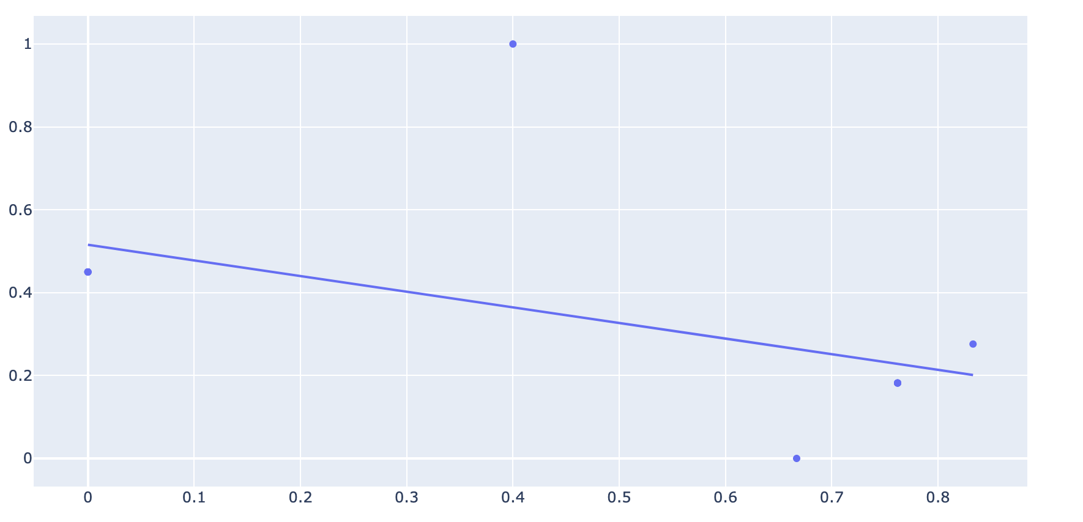
Findings/Insights
Merge DF
Centers
Y-Axis = 3P%
X-Axis = FT%

Slide 10
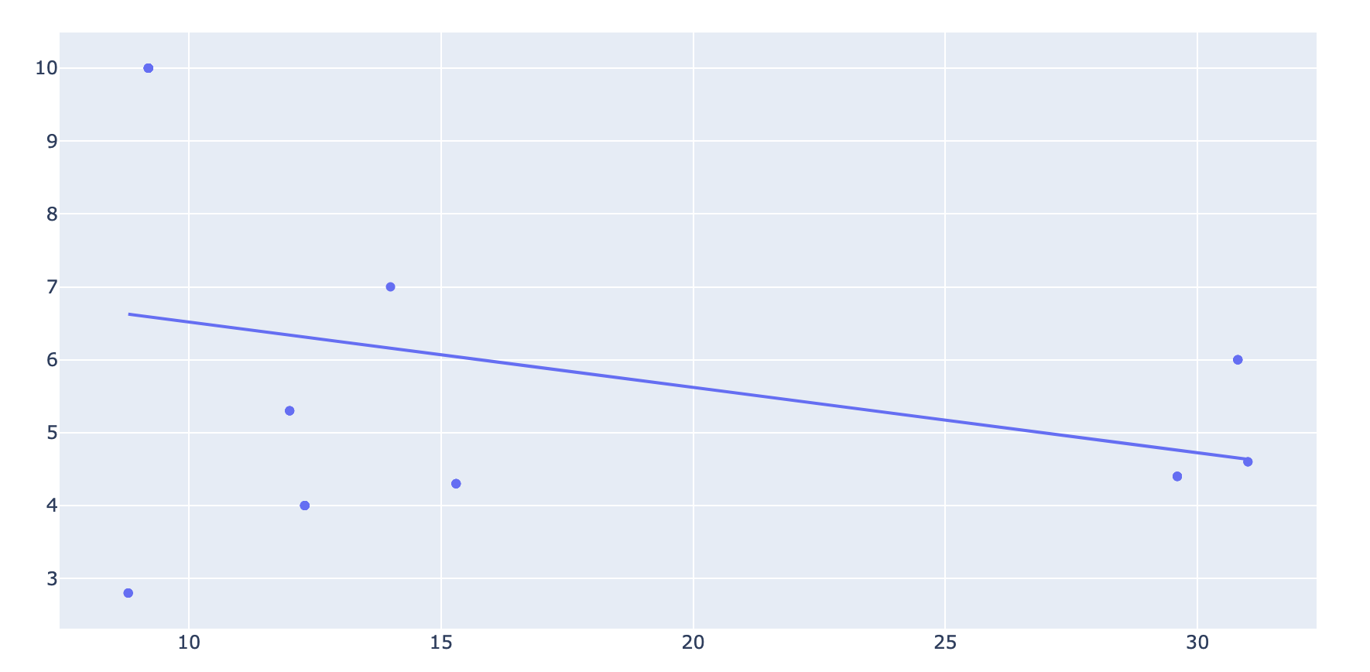
Findings/Insights
PG
X-axis: PTS
Y-axis: AST

Slide 11
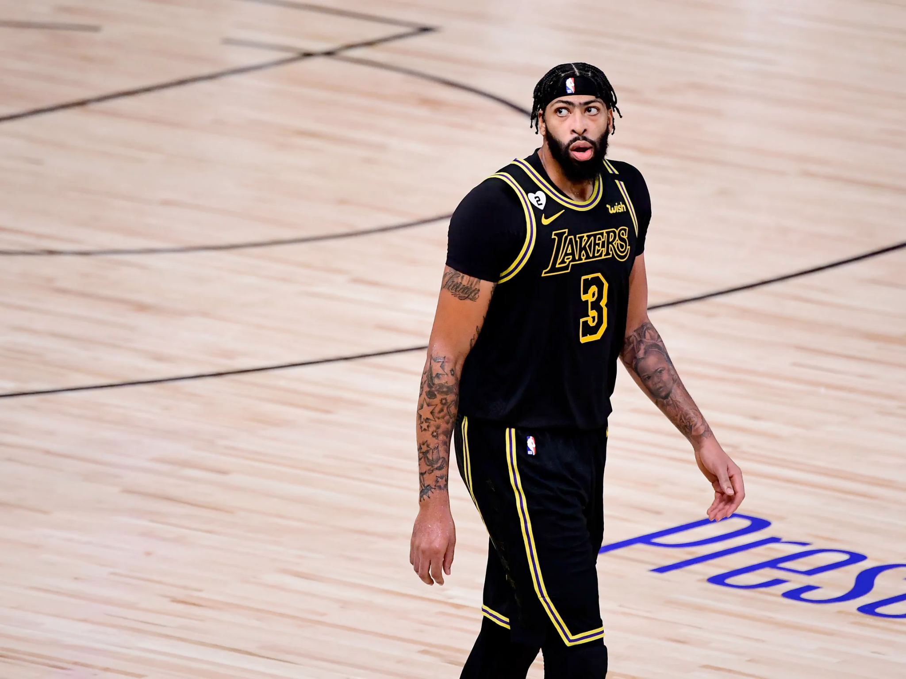
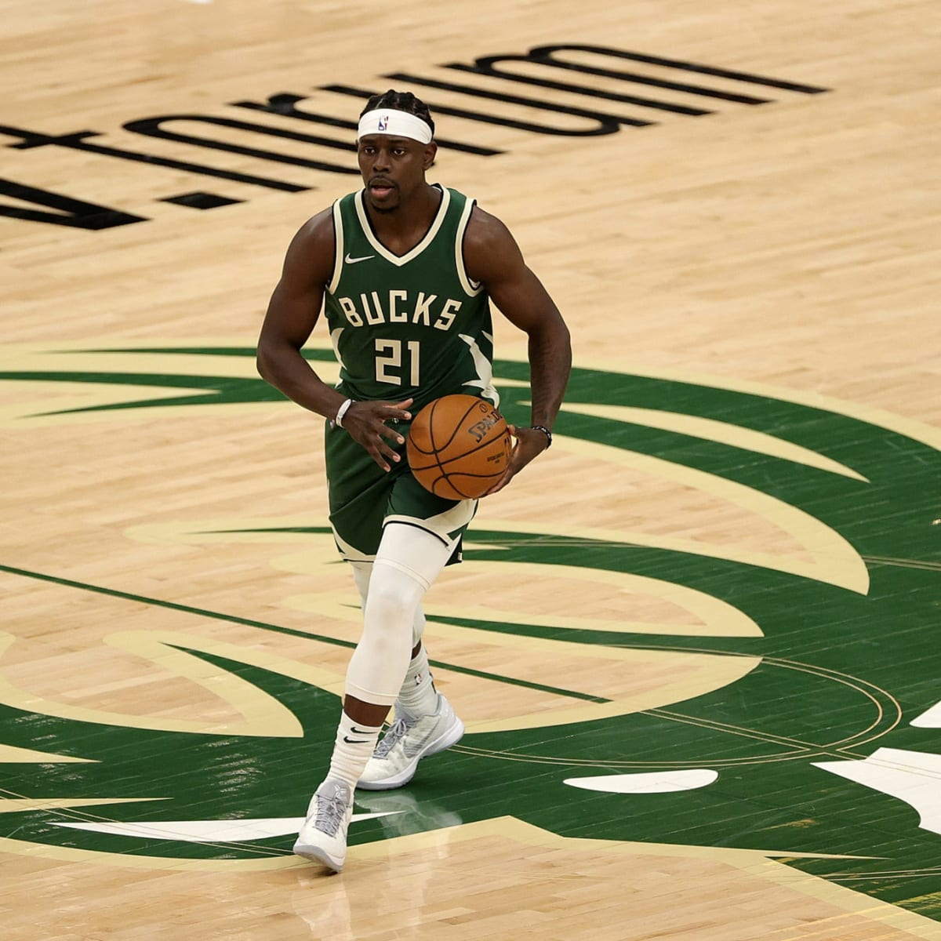
Recommendations
We get trade for Anthony Davis and Jrue holiday

Slide 12
Future?
Trade deadline isn’t until February
Keep looking for other candidates while the deadline
Have alternatives
Put other constraints that we might need

